Slide 1



DEPARTMENT OF ELECTRONICS AND COMMUNICATION ENGINEERING
ECB1332 - DESIGN PROJECT END SEMESTER REVIEW DATE: 06.05.2026
VOLUNTEER MANAGEMENT SYSTEM FOR COLLEGE EVENT
TEAM MEMBERS: GUIDED BY:
KANISHKA D (927623BEC101)
KANISHKA S (927623BEC102)
KANISHKAA S (927623BEC103)
KAVYA V (927623BEC111)
KIRUBA D (927623BEC112)
LAVANYA A (927623BEC122)
Mr. A. ARUL M.E., (Ph.D.,)
Assistant Professor,
Electronics and Communication Engineering, M Kumarasamy College of Engineering.

Slide 2
PROBLEM STATEMENT
Volunteer management is done manually in college events
No centralized system for registration and coordination
Difficulty in assigning tasks to volunteers
Poor communication between organizers and volunteers
Hard to track attendance and performance
Lack of real-time updates and notifications

Slide 3
OBJECTIVES
To develop a centralized platform for easy volunteer registration and management, reducing
manual work and errors.
To simplify task assignment and coordination by helping organizers assign roles and track progress.
To improve communication through real-time notifications and updates for volunteers.
To track attendance and performance using digital records for better evaluation.

Slide 4
ABSTRACT
Manual volunteer management in college events leads to inefficiency and errors.
Proposes a Volunteer Management System to automate registration and coordination.
Provides centralized platform for task assignment and management.
Improves communication through real-time updates and notifications.
Tracks attendance and performance for better evaluation and event success.

Slide 5
PROPOSED METHODOLOGY
System Design
Design a Volunteer Management System integrating both software and hardware components to automate registration, task management, and attendance tracking.
Volunteer Registration Module
Develop a software platform where students can register for events and their data is stored in a centralized
database.
RFID-Based Attendance System
Each volunteer is provided with an RFID card. During events, the RFID reader scans the card to automatically mark attendance in the system.
LCD Display Integration
An LCD display is used to show real-time information such as volunteer name, ID, and attendance status when the RFID card is scanned.

Slide 6
PROPOSED METHODOLOGY
Task Assignment and Management
Organizers assign tasks through the software, and volunteers can view their assigned roles and responsibilities.
Real-Time updation Module
The system updates to volunteers regarding schedules, changes, and instructions.
Database and Performance Tracking
All attendance and activity data are stored digitally, allowing organizers to track performance and generate reports.
System Testing and Implementation
The complete system is tested for accuracy and reliability before being deployed in real college events.

Slide 7
INTRODUCTION
Volunteer management is essential for the smooth execution of college events.
Manual methods are inefficient and lead to errors, poor coordination, and communication issues.
A centralized automated system is needed to manage registration, task assignment, and communication.
Using RFID and software integration helps in easy attendance tracking and improves overall event
management efficiency.

Slide 8
LITERATURE REVIEW
YEAR | AUTHORS | TITLE | INFERENCES | MERITS
2023 | Kashif Ishaq, Samra Bibi | IoT Based Smart Attendance System Using RFID: A Systematic Literature Review | RFID combined with IoT enables automated, real-time attendance tracking and reduces manual errors and proxy attendance. | Improves accuracy and reliability. Easy integration with cloud platforms
2024 | Debashon Chakraborty, Md Maruf Rahman, et al. | Enhanced Security and Efficiency in Attendance Management: A Novel RFID and Arduino Integrated System | Integration of RFID with Arduino improves attendance tracking with better security and automation compared to manual systems. | High security using unique RFID IDs Low-cost and scalable system
2026 | Rohan Raju, Arnav Kulkarni, et al. | Smart Scan: An RFID-Based Automated Attendance System | RFID-based systems automate attendance without human intervention and improve efficiency in institutions. | Fast and efficient operation Real-time display using hardware

Slide 9
EXISTING METHODOLOGY
Current volunteer management in college events involves:
Manual registration using paper or spreadsheets
No centralized system for managing volunteers
Manual task assignment by organizers
Attendance marked manually or verbally
Limited or no real-time communication
Disadvantages:
Time-consuming and prone to human errors
Difficulty in tracking volunteer participation
Poor communication between organizers and volunteers
No real-time updates or notifications
Lack of proper attendance and performance records
Inefficient coordination during events

Slide 10
TECHNOLOGY USED
Frontend - We used HTML and CSS design the user interface of the system.
HTML → to create web pages, CSS → to style the pages
Backend - We used Python with Flask frame work to handle the backend operations. Flask helps to connect frontend and data base. It processes user requests and sends responses
Database - We used SQLite data base to store volunteer details and event data. It stores data like name, role, tasks, etc. It is lightweight and easy to use

Slide 11
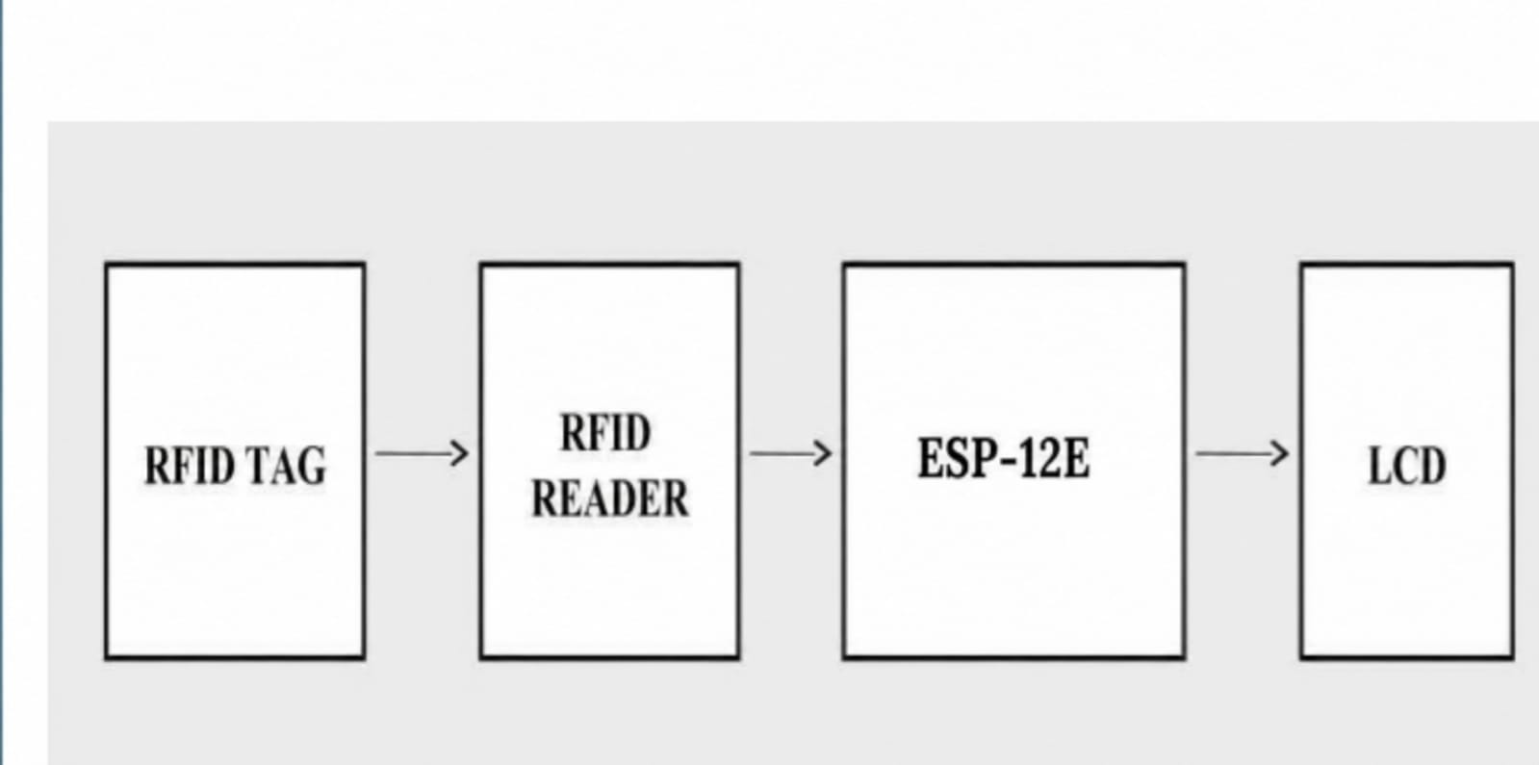
BLOCK DIAGRAM OF PROPOSED METHODOLOGY
Feasibility & Viability
Technically feasible – Uses simple and available technology.
Economically feasible – Low cost and affordable.
Operationally feasible – Easy to use and manage.
Practically viable – Saves time
and improves efficiency.

Slide 12
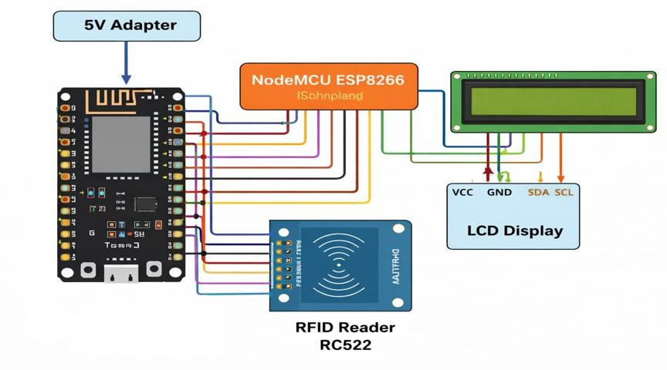
CIRCUIT DIAGRAM

Slide 13
INNOVATIVE ASPECTS AND BENEFITS
TARGET AUDIENCE
Residential monitoring
users for daily usage and students/researchers
INNOVATION AND UNIQUENESS
Real-time monitoring with live visualization
Smart analysis of usage patterns
User-friendly dashboard interface
Automated data collection and processing
Fast and reliable system performance
working on IoT projects.
Smart home developers, IoT enthusiasts, and small-scale industries or offices for energy tracking and efficiency improvement.
SOCIETAL BENEFITS
Promotes efficient energy usage
Reduces electricity costs
Improves user awareness through real-time insights
Supports sustainability and smart energy management

Slide 14
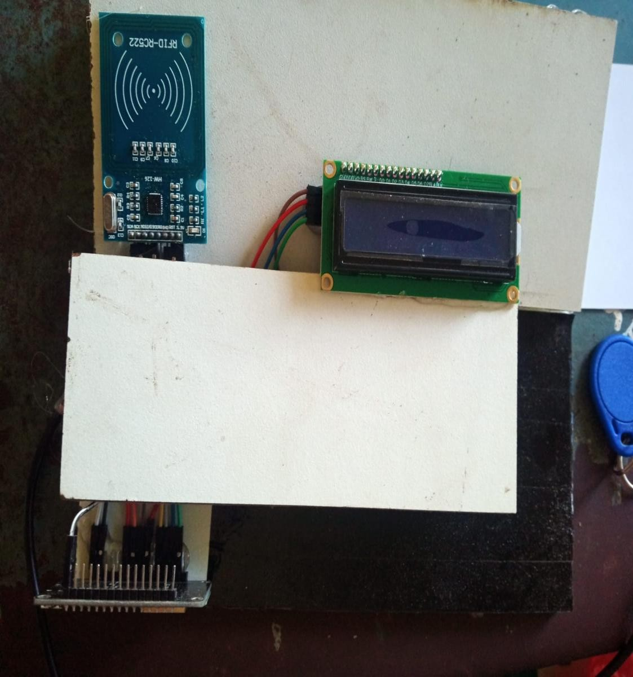
WORK MODULE COMPLETION STATUS (HARDWARE)
Hardware module designed and tested
Sensors calibrated successfully
Dashboard developed
Data communication & visualization verified

Slide 15
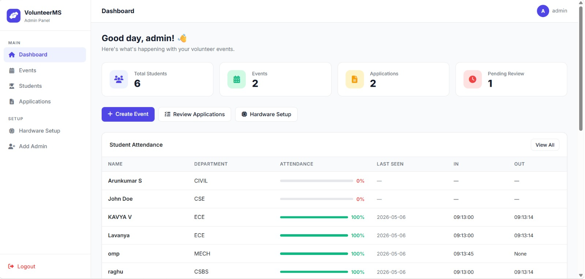
WORK MODULE COMPLETION STATUS (SOFTWARE)
Admin Dashboard

Slide 16
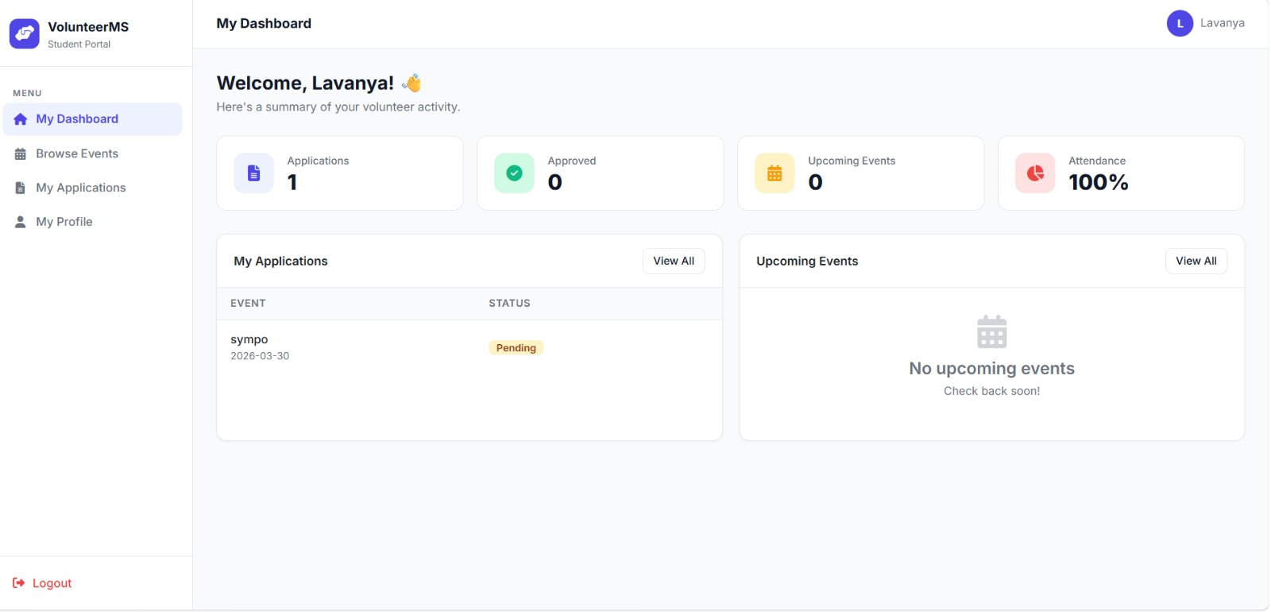
WORK MODULE COMPLETION STATUS (SOFTWARE)
Student Dashboard

Slide 17
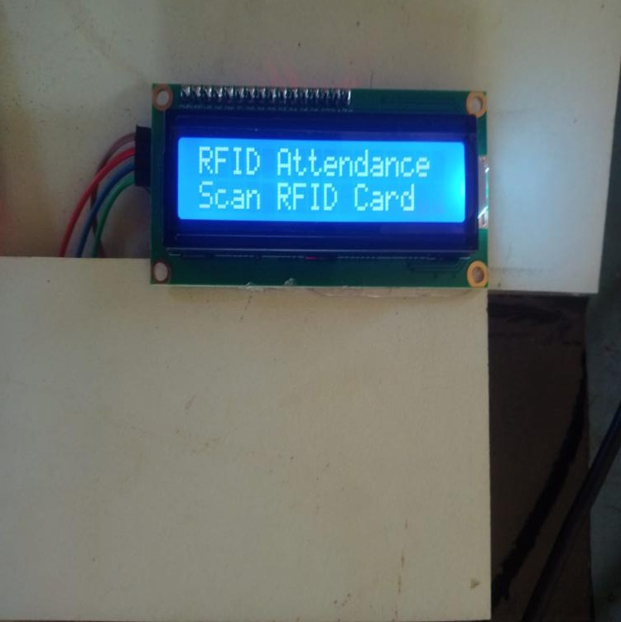
RESULTS AND DISCUSSION
The successful implementation of the proposed project is validated through the system outputs obtained during testing.
The results demonstrate the proper functioning of key modules such as data acquisition, processing, visualization, and user interaction.
The observed outputs confirm that the system operates efficiently and provides accurate and reliable performance as
intended.
The overall results show that the proposed system meets the project objectives and delivers effective real-time or simulated outcomes.

Slide 18
THANK YOU!

